Slide 1


Silent Scraper academy
Under Supervision
Dr/Ahmed Fawzy
Eng/Mina

Slide 2
Team Members
1. Karim Mohamed Hussien
2. Ebrahim Hesham Awd
3. Mohamed Hesham Mohamed
4. Kerolos Adeeb Dawoud
5. Karim Tarek Elsaid
6. Mohamed Ahmed Sayed
7. Mostafa Ahmed
8. Youssef Ayman Mohamed
9. Mohamed Ebrahim Mohamed
10. Mohamed ElSayed Mohamed
11. Mostafa Mohe Mohamed

Slide 3
Outline:
1. Introduction and Overview
2. UI & UX (Frontend)
3. Backend & Apis
4. Web / Network Tools
5. Vulnerability Labs
6. Resources & Challenges
7. Conclusion & Future Path

Slide 4
Aim & Objective
Our Academy Objective :
Build a web platform for learning and practicing cybersecurity through a simple user interface.
Connected tools that runs tools like Sub finder, Nmap, and Asset Finder via Fast API.
Provide practical labs with real vulnerabilities in web and network environments.
Help students and trainees perform real scans and analyze results in a safe training environment.
We Are Targeting Security Researchers And Beginner Cybersecurity Audience

Slide 5
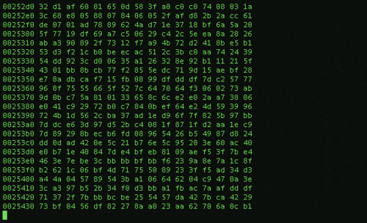

Introduction
SilentScraper is a web-based platform. It helps users practice ethical hacking. You can exploit real-world vulnerabilities. Labs are safe and sandboxed. Empowering cybersecurity professionals is our goal. We provide hands-on experience.

Slide 6



Project Frontend: Diving Deep into UI/UX
React.js
Home and TeamMember cards
Styling with CSS
Vite / JavaScript & Libraries

Slide 7


Backend ( Node.js )
Api Requests
Backend Divided Into
Database (XAMPP/Apache)
Why I Choose Fast API?
How it implements !!
Frontend & Backend Link using the API

Slide 8

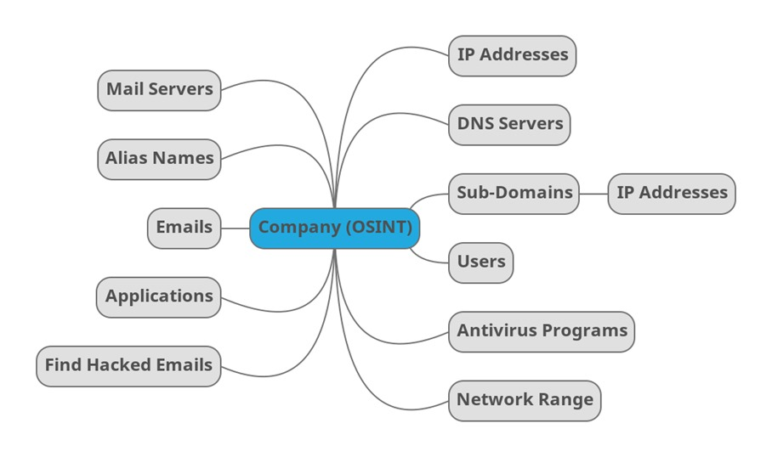
What is OSINT?
Where Does OSINT Come From?
What is OSINT Used For?
Why OSINT Matters?
Notes:
1. What is OSINT?
OSINT stands for Open Source Intelligence.
It means collecting information from publicly available sources — anything that’s open and legal to access on the internet or offline
2. Where Does OSINT Come From?
OSINT data can come from:
Websites
Domain records (like WHOIS)
Public documents and government databases
Code repositories (like GitHub)
Archived data (like Wayback Machine)
3. Why OSINT Matters?
It’s free
It’s legal
It helps find hidden info
It gives a head start in investigations or hacking ethically
4. What is OSINT Used For?
OSINT is used in many fields:
Cybersecurity: To find weaknesses or exposed information before hackers do.
Bug Bounty / Pentesting: To gather info about the target.
Threat Intelligence: To track attackers or leaked data.
Law Enforcement / Military: For investigations or tracking threats.
Journalism: To investigate stories.
Corporate Security: To monitor brand or employee leaks.

Slide 9
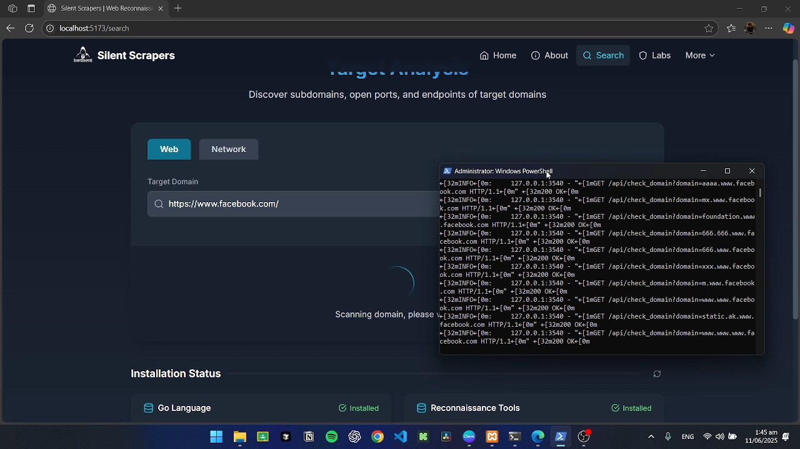




Web & Network Tools
Subfinder & Asset finder & Sub lister
Discover subdomains and external assets. Identify potential attack surfaces.
Katana & Gau
Perform fast port scanning. Automate web crawling for structure.
ASN Lookup
Retrieve known URLs. Identify network ownership (ASN).
Nmap & Naabu
Advanced network scanning. Get detailed host and service information.

Slide 10
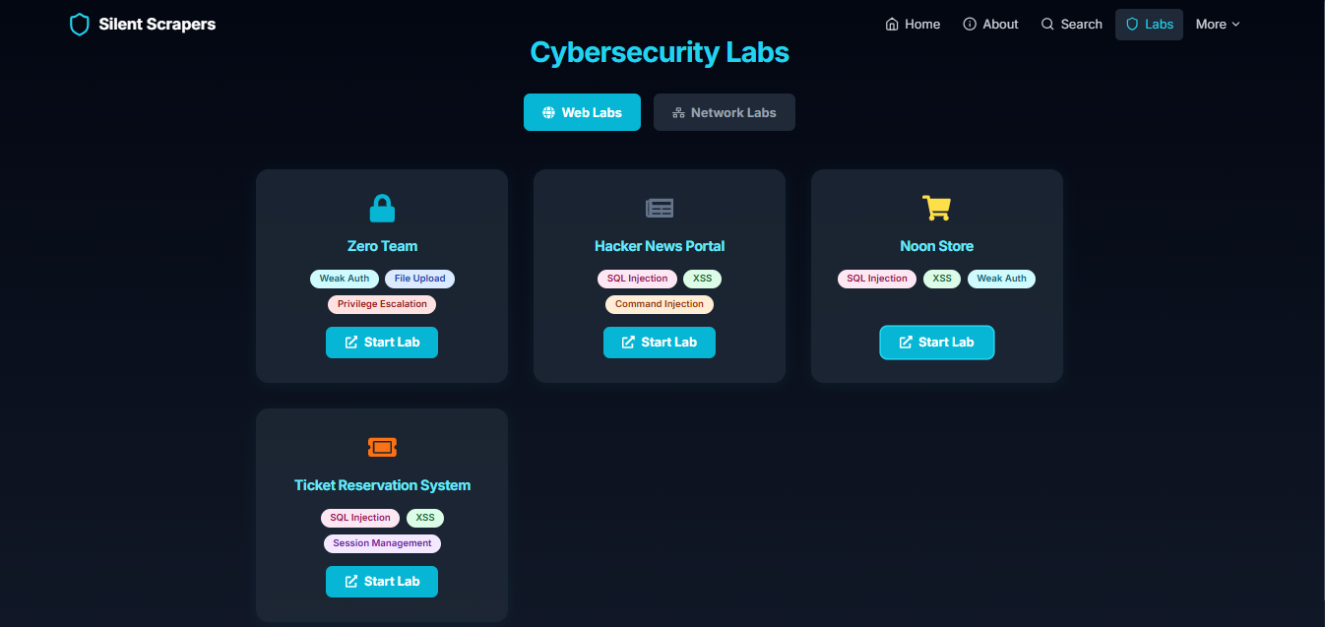
Hands-On Vulnerability Labs
Lab 1 : Zero Team
Lab 2 : Hacker News
It is a website for managing an organization or company.
It is a site for uploading or viewing interesting articles.
Lab 3 : Noon Store
Lab 4 : Ticket Reservation
It is an online product shopping site.
It is a website for booking travel tickets and hotel accommodation.

Slide 11
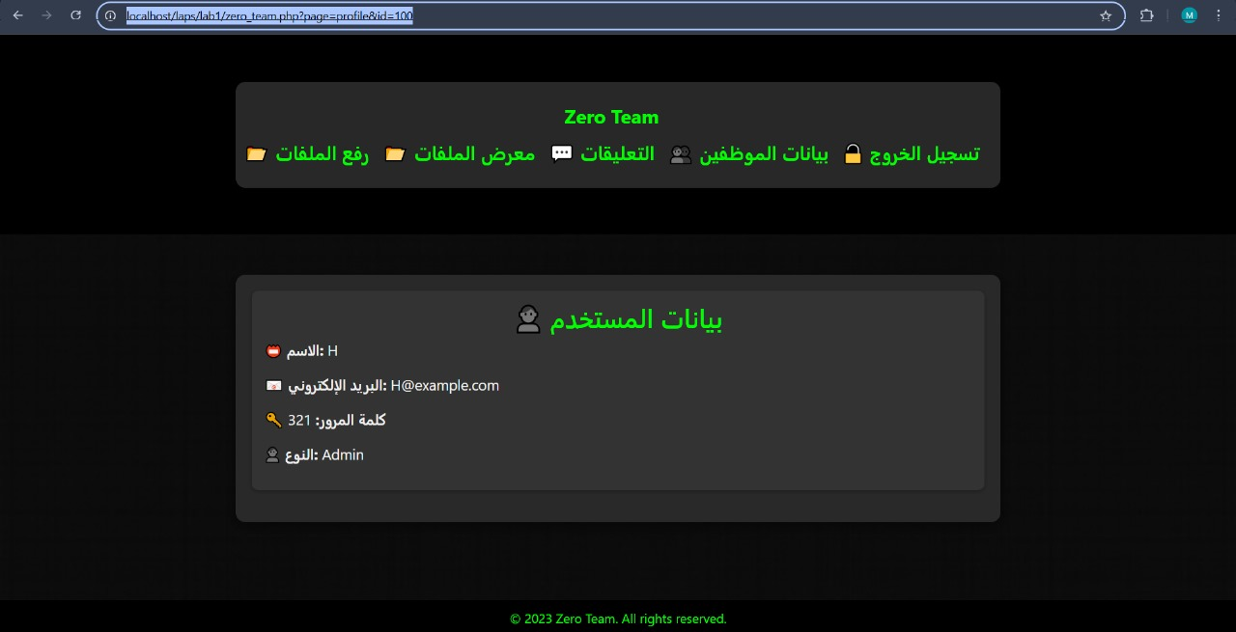
Zero Team
File upload – IDOR
Way of Exploitation
Outcome & Impact
Isolation Method

Slide 12
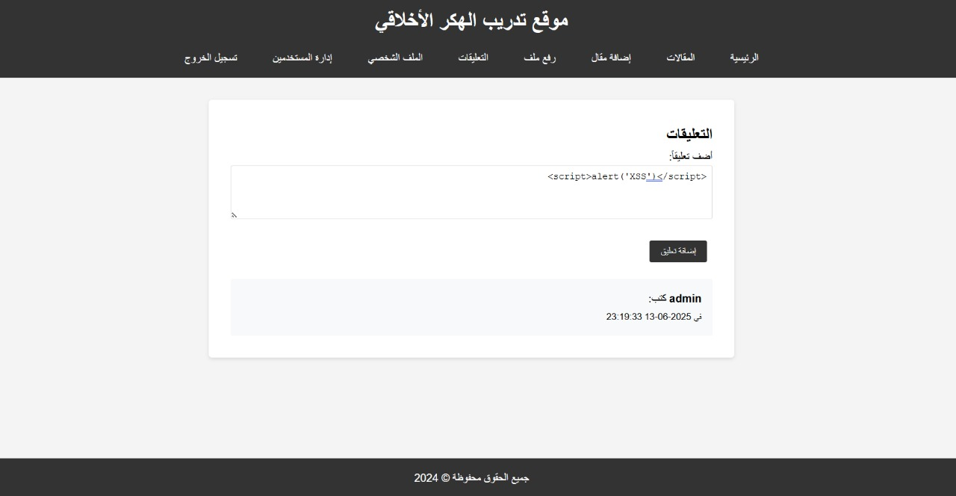
Hackers News
XSS – Command Injection
Way of Exploitation
Outcome & Impact
Isolation Method

Slide 13
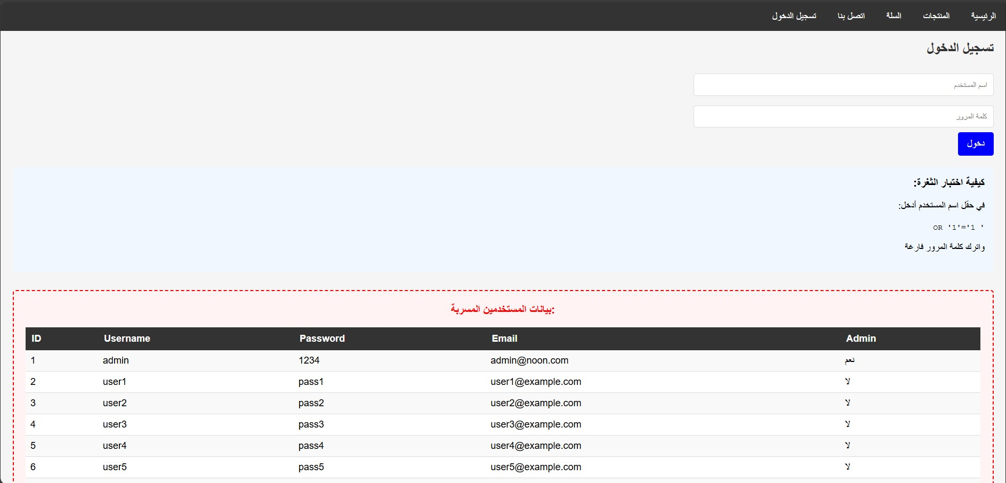
Noon Team
SQL injection - XSS
Way of Exploitation
Outcome & Impact
Isolation Method

Slide 14
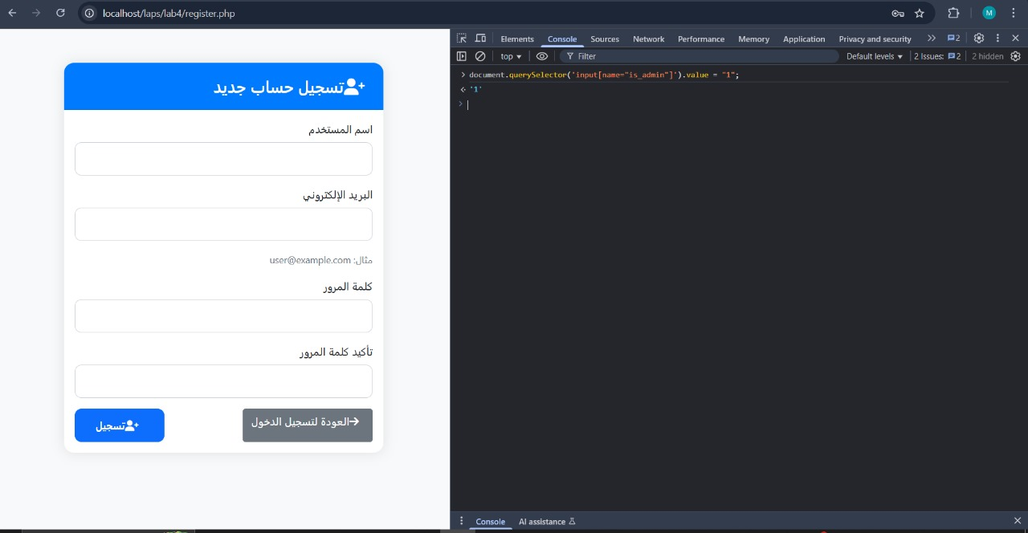
Ticket Reservation
IDOR – Tool Manipulation
Way of Exploitation
Outcome & Impact
Isolation Method

Slide 15
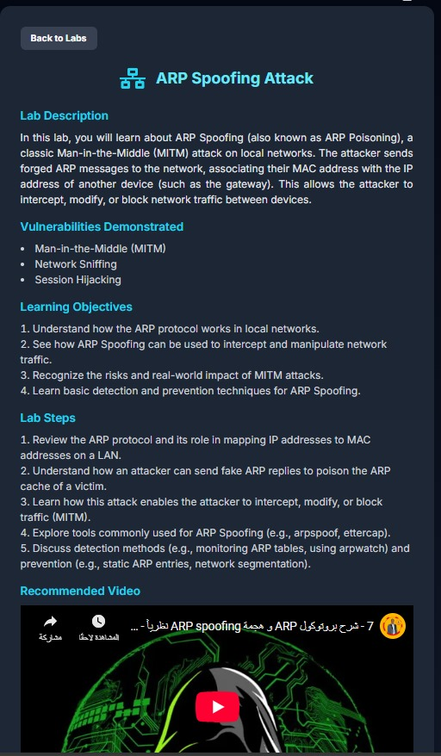
ARP Spoofing
Session Hijacking – MITM(MAN IN THE MIDDLE)
Way of Exploitation
Outcome & Impact
Isolation Method

Slide 16
ARP Spoofing
Session Hijacking – MITM(MAN IN THE MIDDLE)
Way of Exploitation
Outcome & Impact
Isolation Method

Slide 17
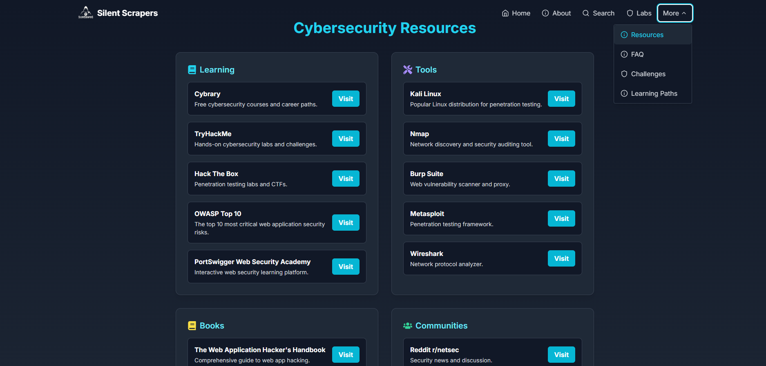
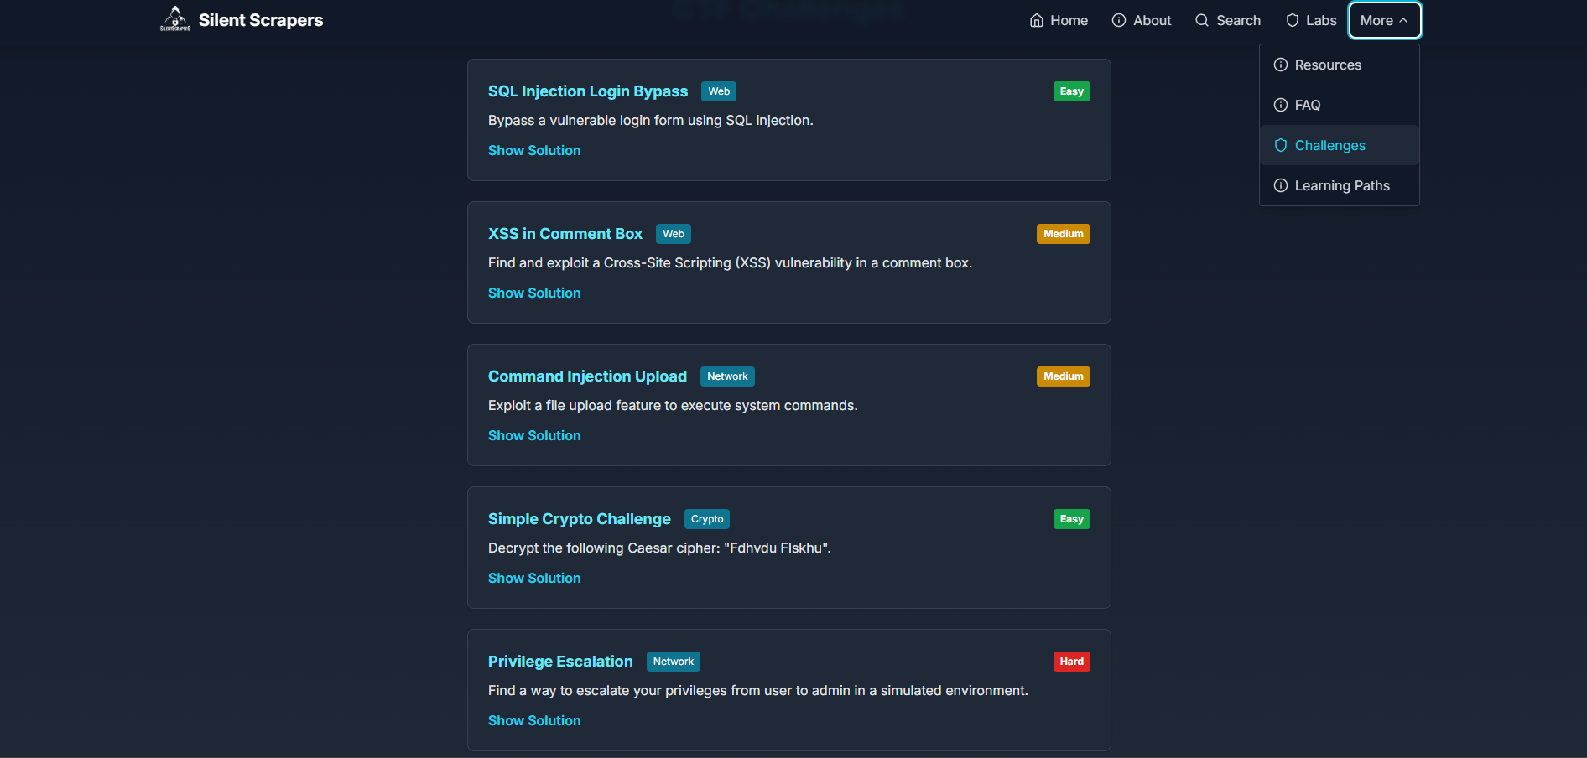
Resources:
Challenges:
These tabs are used as a reference for the user to facilitate the search and use of all the tools available in the academy and also to increase the information and credibility of our platform.
This contains common problems and vulnerabilities that can pose a challenge or danger to all websites, commercial institutions, companies in all sectors, and also digital countries.

Slide 18




Who is SilentScraper For?
Cybersecurity
Students
Security Professionals
Developers
Bug Bounty Hunters
Learn ethical hacking and penetration testing skills.
Enhance skills with advanced exploitation techniques.
Understand secure code writing. Prevent common vulnerabilities.
Identify and report vulnerabilities. Find bugs in real applications.

Slide 19


SilentScraper Business Model
Enterprise Plans
2
Customized training programs. For corporate security teams.
Subscription-Based
Access all labs and features. Pay monthly or annually.
1
Partnerships
Collaborate with training providers. Work with educational institutions.
3

Slide 20

Future Plans
Expand Lab Library
Add new labs. Cover emerging vulnerabilities and attack techniques.
Introduce Gamification
Incorporate leaderboards and badges. Reward users for progress.
Develop Certification Program
Offer industry-recognized certifications. Validate user skills.
Integrate AI-Powered Tools
Automate vulnerability discovery. Enhance analysis capabilities.

Slide 21
Join the SilentScraper Community
Start your cybersecurity journey today! Visit our website. Sign up for a free trial. Follow us on social media. Get the latest updates and news. Master ethical hacking skills.

